Slide 1
Inventory Management System
Names of People

Slide 2
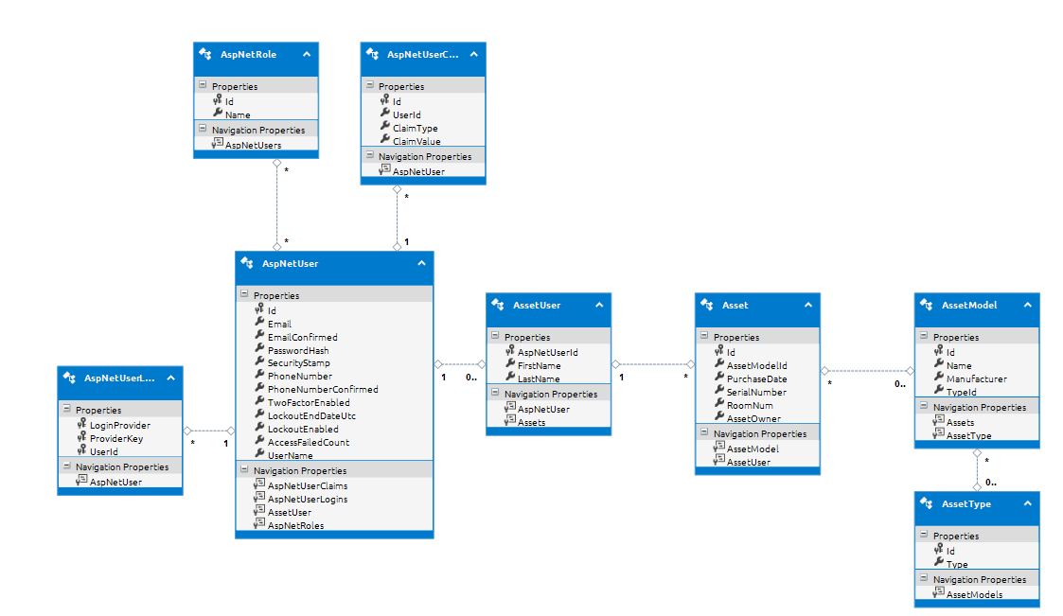
Class Model/EDMX

Slide 3
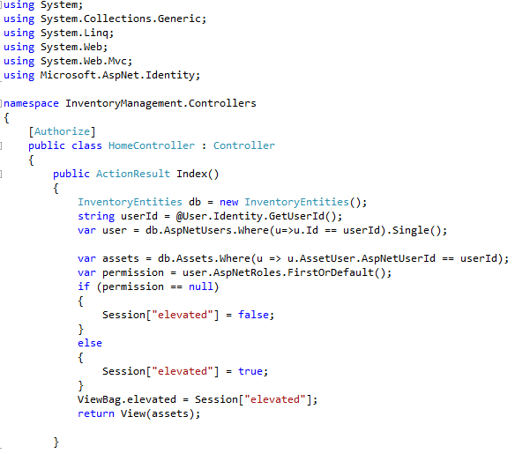
Home Controller

Slide 4
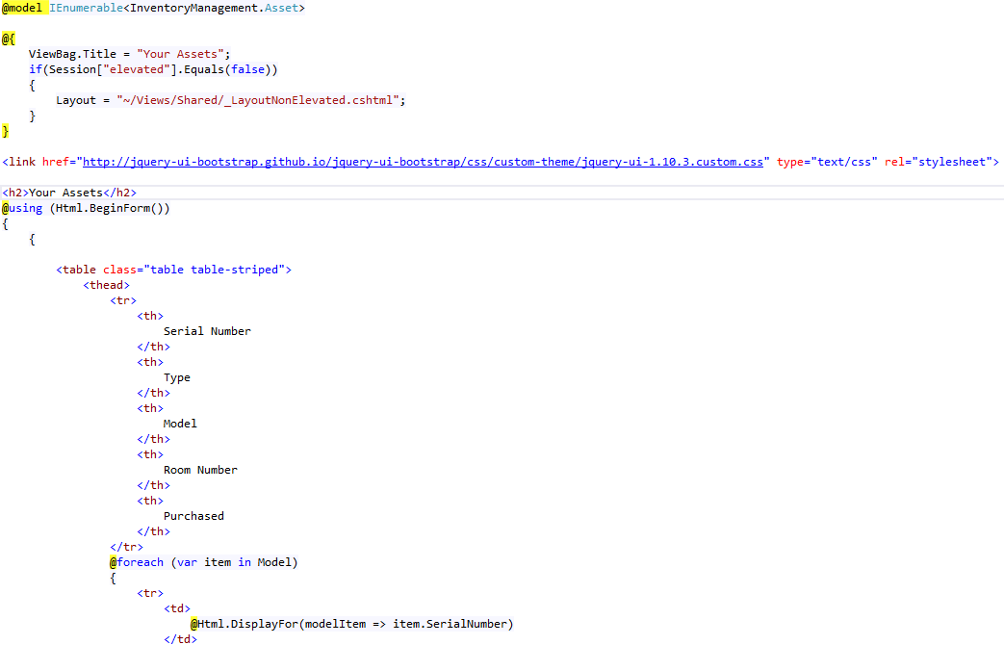
Index View

Slide 5
Asset Search

Slide 6
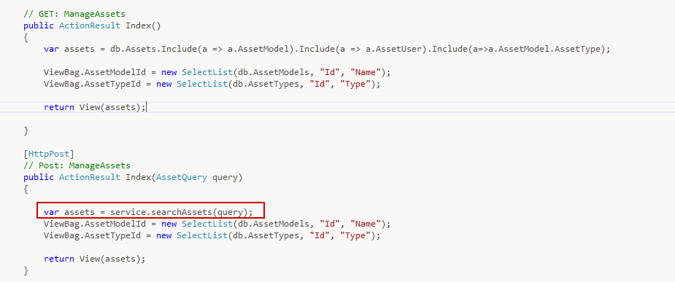
Controller

Slide 7
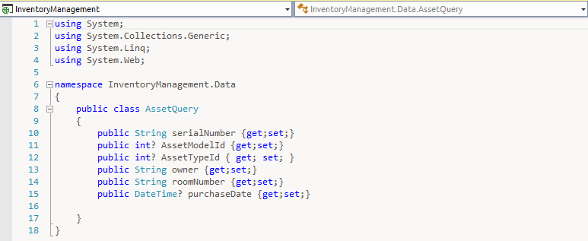
Query Class

Slide 8
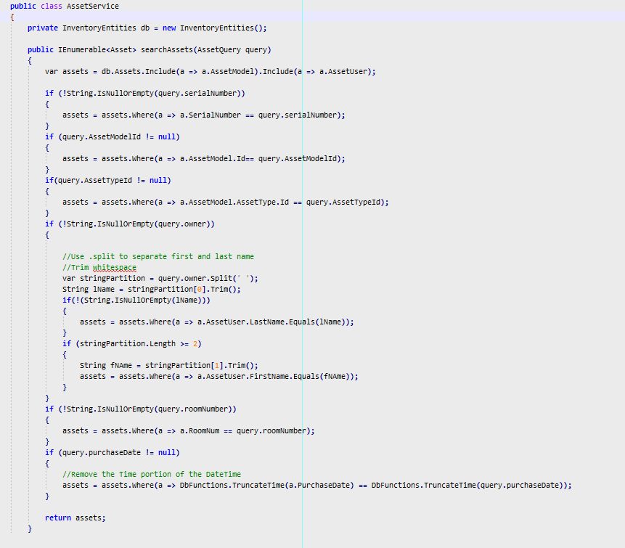
Search Logic

Slide 9
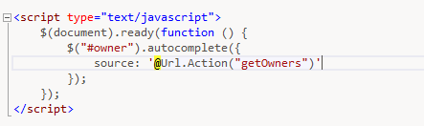
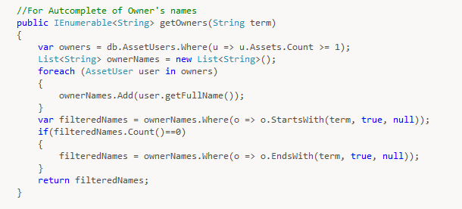
Autocomplete

Slide 10
Edit

Slide 11
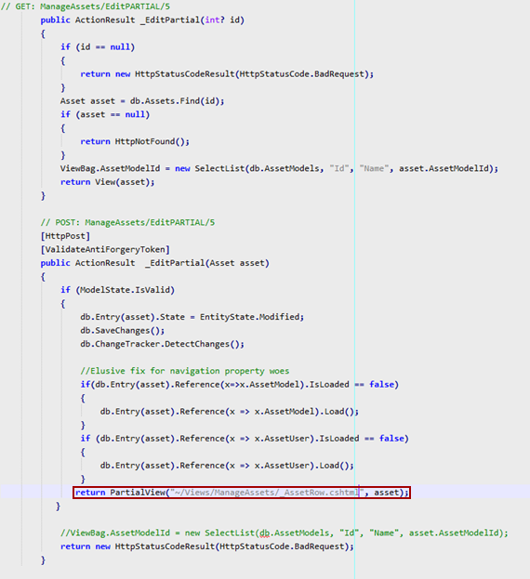
Controller

Slide 12
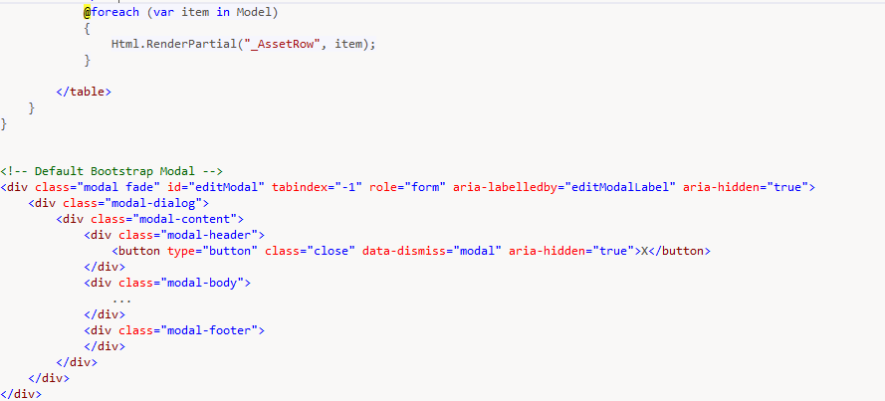
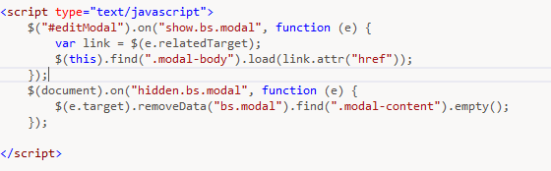
View – Partial Rows & Modal

Slide 13
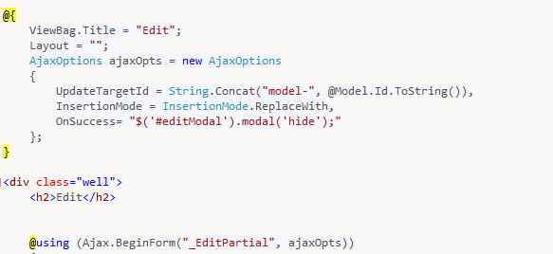
Ajax Form

Slide 14
ORM – Entity Framework
Uses simple common syntax (LINQ) to Add/Read/Delete/Update objects.
No need to deal with writing much SQL
Handles object-relational mapping (ORM) on its own.
Builds scaffolding for controllers and views based on models

Slide 15
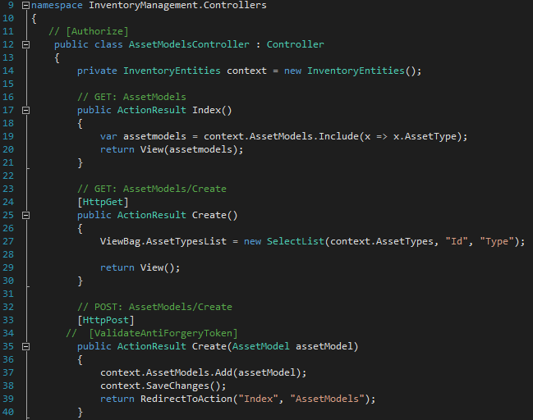
Asset Models – CRUD

Slide 16
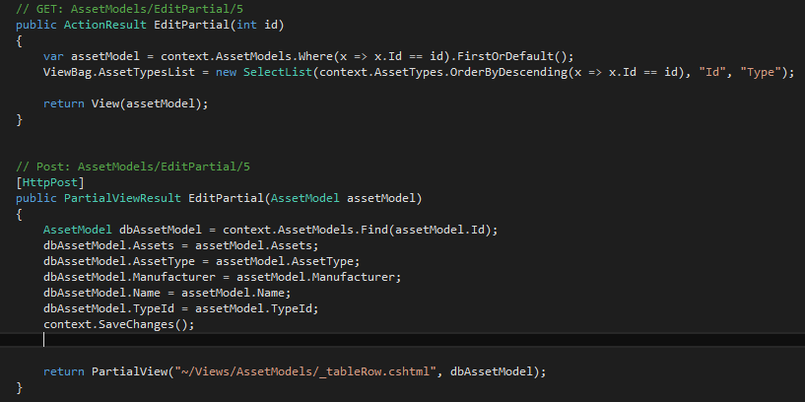
Asset Models - CRUD

Slide 17
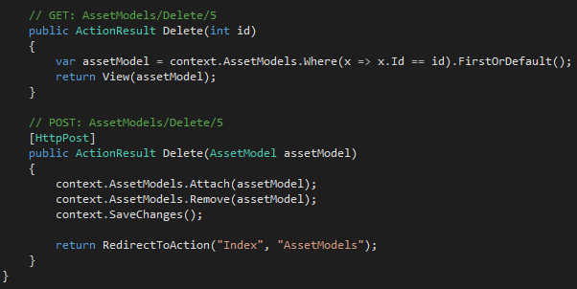
Asset Models - CRUD

Slide 18
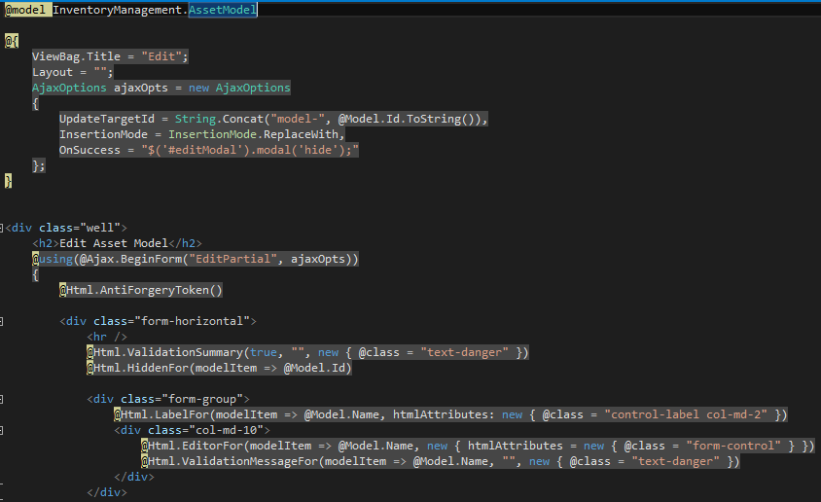
Asset Models – Edit View

Slide 19
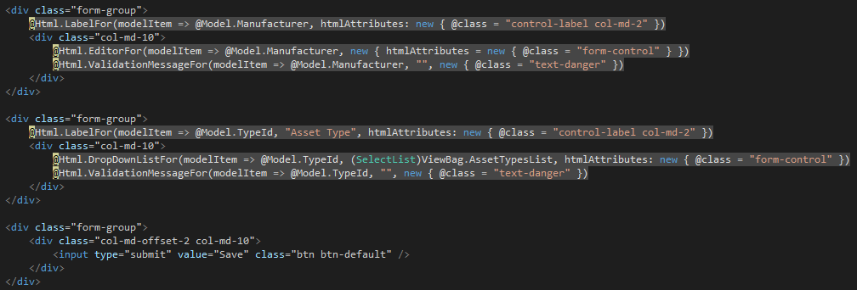
Asset Models – Edit View

Slide 20
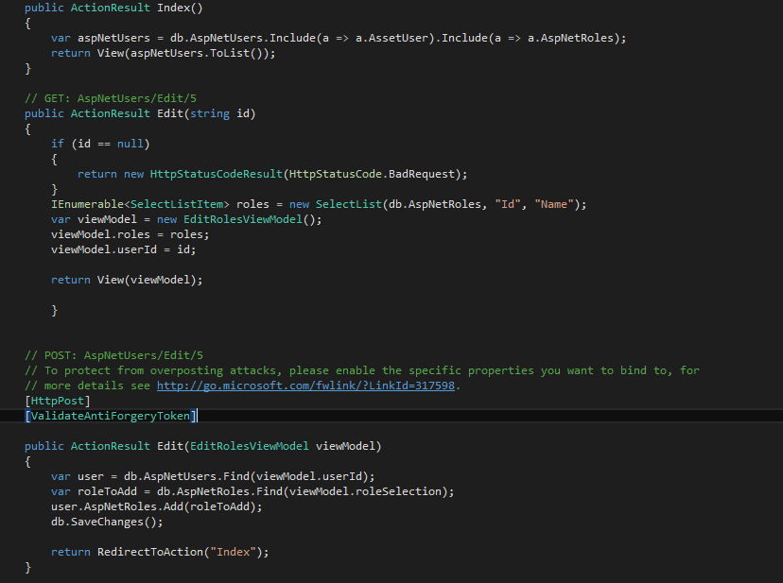
User Roles Page

